Slide 1


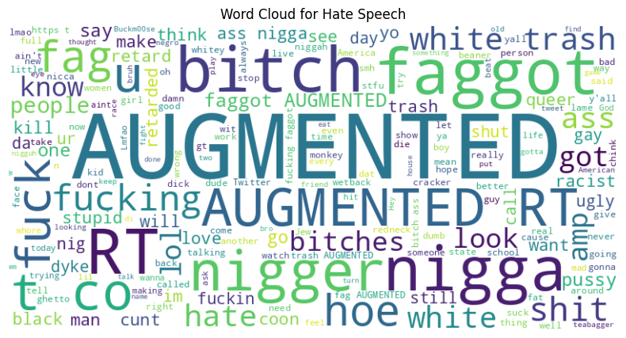
Home
Services
Features
About Us
Contact
CSE449
Hate Speech and Offensive Language Detection
Raiyanul Islam Siam | 24141261
BRAC UNIVERSITY

Slide 2




Home
Services
Features
About Us
Contact
Motivation & Problem Statement
Growth of harmful content on social media.
Need for automated hate speech detection.
Goal: Build and adapt a machine learning pipeline for this task.

Slide 3
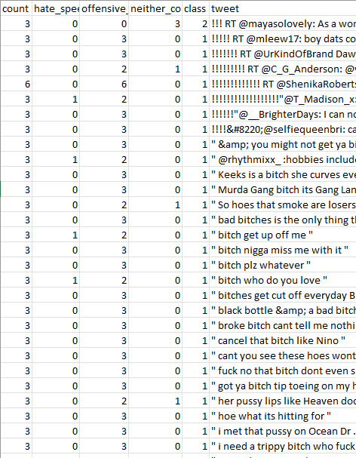

Home
Services
Features
About Us
Contact
Dataset Overview
Source: Twitter annotated dataset (train.csv).
Columns: count, hate_speech_count, offensive_language_count, neither_count, tweet.
Size: ~25k tweets (annotated).
Challenge: Class imbalance (offensive language dominant).
Dataset: https://www.kaggle.com/datasets/thedevastator/hate-speech-and-offensive-language-detection

Slide 4

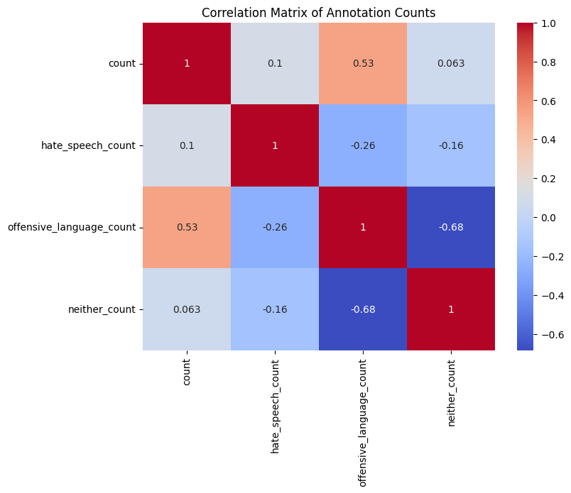
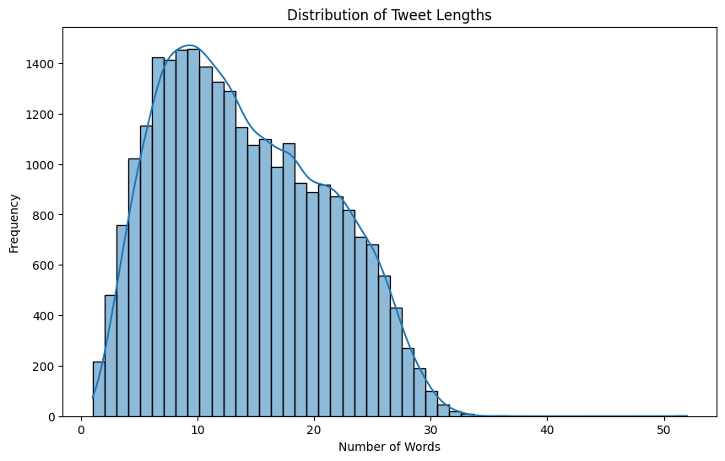
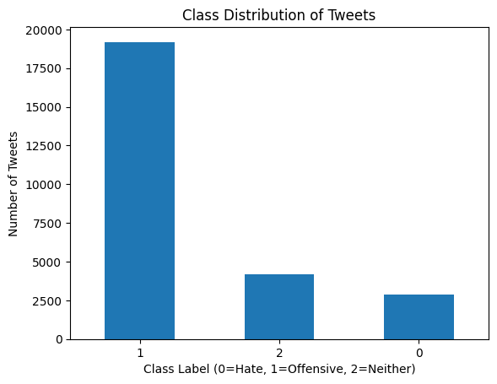
Home
Services
Features
About Us
Contact
Exploratory Data analysis
Confusion Matrix of Annotation Count
Distribution of Tweet Length
Class Distribution of Tweet
Seaborn - Python data visualization library built on top of Matplotlib.

Slide 5

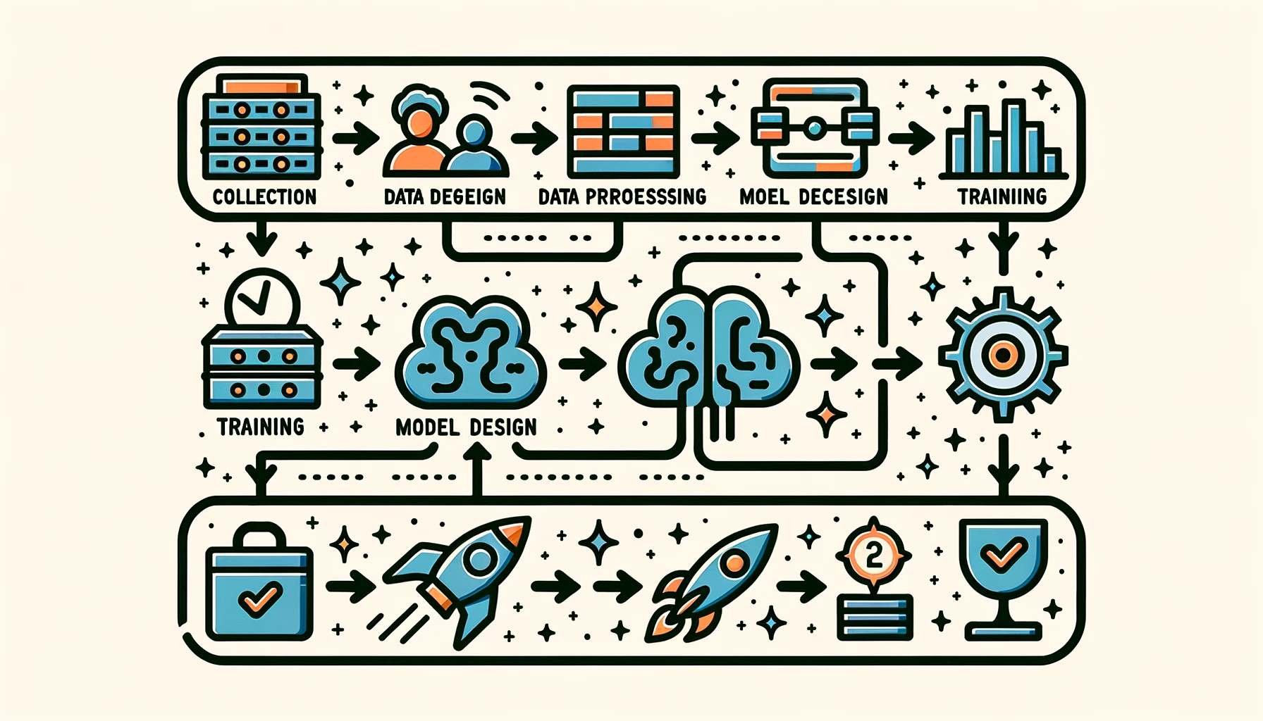


Home
Services
Features
About Us
Contact
Project Workflow
Parallel Data Augmentation
Data Cleaning & Preprocessing
Model & Evaluation Metrics

Slide 6


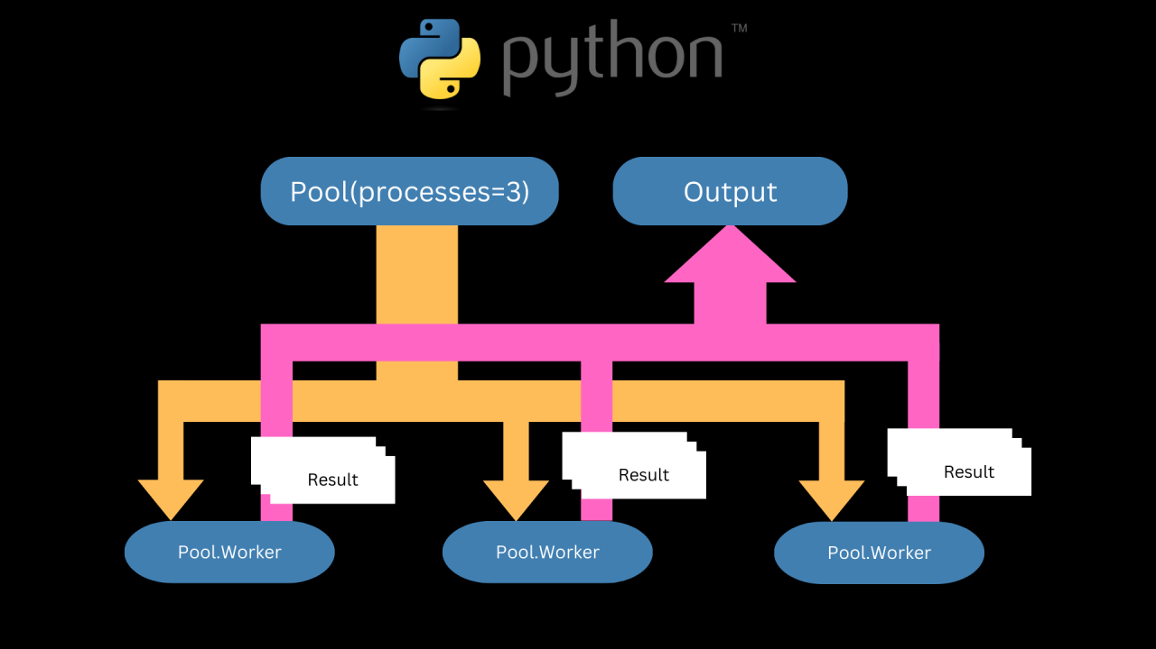
Home
Services
Features
About Us
Contact
PArallel
Data augmentation
Data Quality Matters
System: Number of posts in the minority class to augment: 1430
Performance Results:
Sequential run time: 14.75 seconds
Parallel run time on 4 crores: 3.86 seconds
Speedup: 3.82x
Architecture
Back Translation
Data augmentation is a technique to artificially expand my dataset by creating new, slightly modified samples. For text, this often includes:
Back-translation (translate to another language → back to English).
Synonym replacement.
Random insertion/deletion of words.
Python Multiprocessing module to distribute the tasks across multiple CPU cores
TQDM to visualize the speed bars

Slide 7


Home
Services
Features
About Us
Contact
Data Cleaning & Preprocessing
Remove Noise
In the preprocessing stage, URLs, user mentions, hashtags, and punctuation are removed. This helps eliminate unnecessary symbols and links that do not contribute to the semantic meaning of the text.
Text Normalization:
All tweets are converted to lowercase to maintain consistency and avoid treating words like "Hate" and "hate" as different tokens. Extra spaces are also normalized to create cleaner text inputs.
Tokenization & Padding:
The cleaned text is then tokenized, meaning it is split into individual words and mapped to numerical indices. To ensure uniform input length for the model, sequences are padded so that shorter tweets match the required size.

Slide 8

Home
Services
Features
About Us
Contact
Model and Evaluation Metrics
LSTM+CNN 64, dropout=0.3, recurrent_dropout=0.3)
Total Parameters: 38,27,347
Embedding( vocab_size, 200 ) – word vectors
Dropout(0.5) Dense(128, relu) Output: Dense(3, softmax)
Optimizer: Adam
Loss: Categorical Crossentropy
Metrics: Accuracy, F1, Precision, Recall
Batch size: 64, Epochs: 10

Slide 9
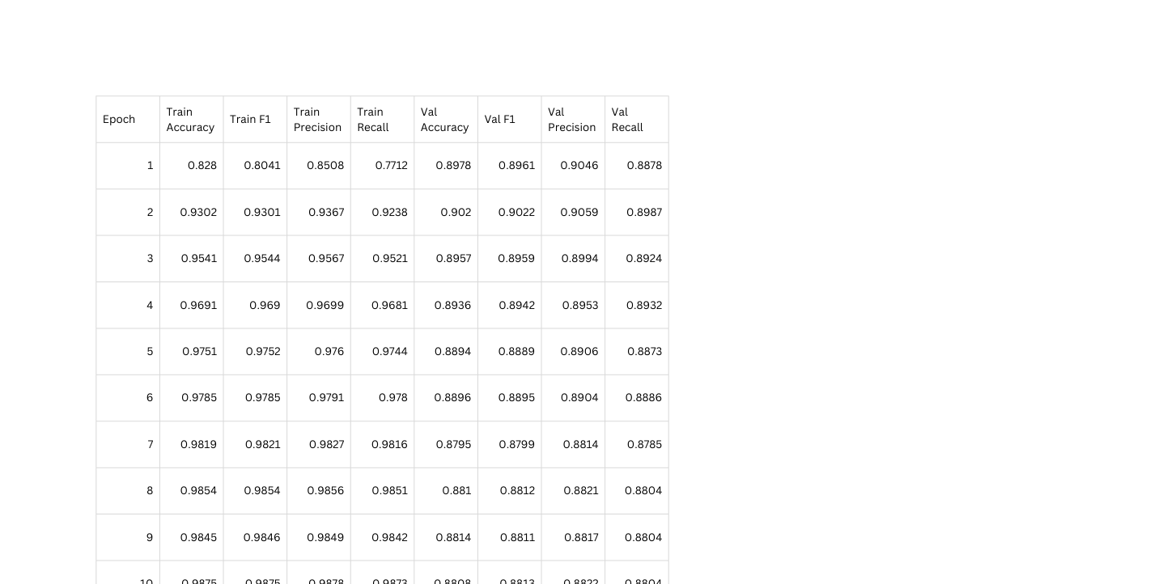
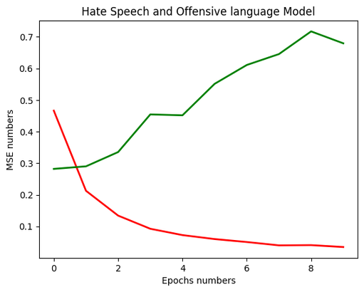
Home
Services
Features
About Us
Contact
OUTPUT METRICS

Slide 10

Home
Services
Features
About Us
Contact
future work
Transformer Models: Explore BERT, RoBERTa, or DistilBERT for better context understanding.
Multilingual Extension: Train on datasets in multiple languages to detect hate speech globally.
Class Imbalance Handling: Apply SMOTE, class weights, or advanced sampling methods.
Explainable AI Dashboards: Use SHAP/LIME for real-time interpretability and model transparency.
Deployment as Web App: Build a lightweight application for automated content moderation on social media.

Slide 11
Home
Services
Features
About Us
Contact
Thank You

